Slide 1
More indepth look at MapReduce
Not required for the exam!

Slide 2
Overview over this video
This video will show some more examples of MapReduce and then go in to more details with the framework

Slide 3
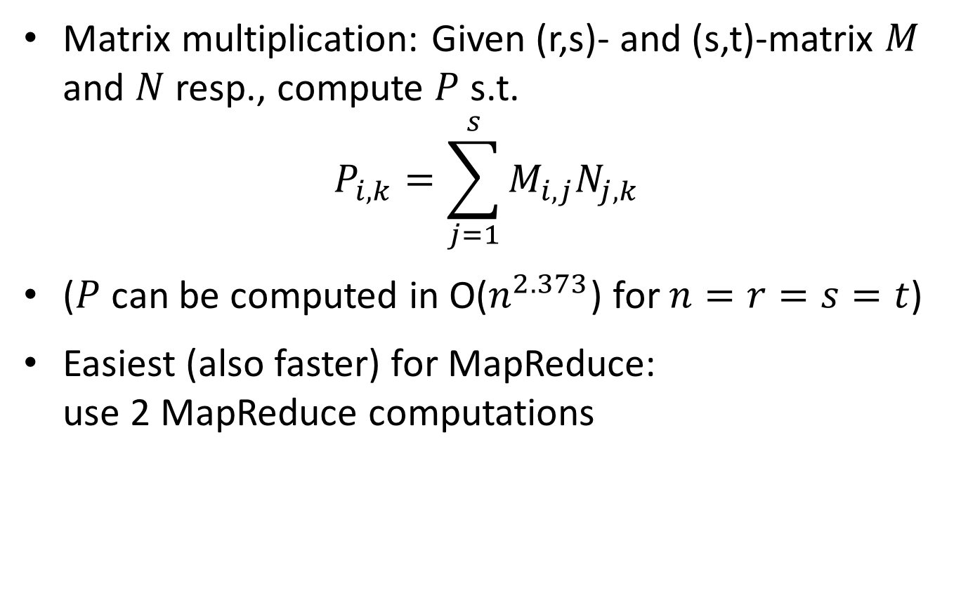
Matrix multiplication
Matrix multiplication: Given (r,s)- and (s,t)-matrix $M$ and $N$ resp., compute $P$ s.t.
$$P_{i,k}=\sum_{j=1}^{s}{M_{i,j}N_{j,k}}$$
($P$ can be computed in O($n^{2.373}$) for $n=r=s=t$)
Easiest (also faster) for MapReduce: use 2 MapReduce computations

Slide 4
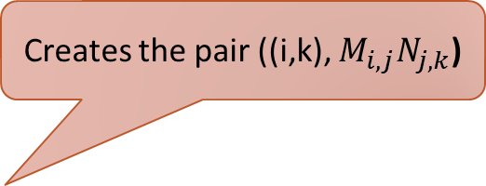


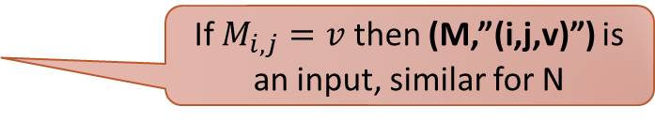
First MapReduce
matrix $∈\{N,M\}$ and triplet $∈ℤ_{+}×ℤ_{+}×ℝ$
Map(String matrix, String triplet):
If $M_{i,j}=v$ then (M,”(i,j,v)”) is an input, similar for N
let (i,j,v) = triplet
if matrix = N then output pair (i, (N,j,v))
else output pair (j, (M,i,v))
Reduce(int no, Iterator<String> values):
for each (S,x,k) in values:
if S=M then:
Creates the pair ((i,k), $M_{i,j}N_{j,k}$)
for each (S’,x’,k’) in values:
if S’=N then:
output pair ((x,x’),$k×k′$)

Slide 5
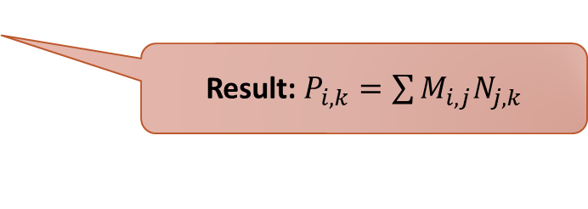

Second MapReduce
Map(pair<int,int> pair, double no):
output pair (pair,no)
Reduce(pair<int,int> pair, Iterator<double> numbers):
double result=0
Number: $M_{i,j}N_{j,k}$
for each number in numbers:
result=result + number
output pair (pair,result)
Result: $P_{i,k}=\sum{M_{i,j}N_{j,k}}$

Slide 6
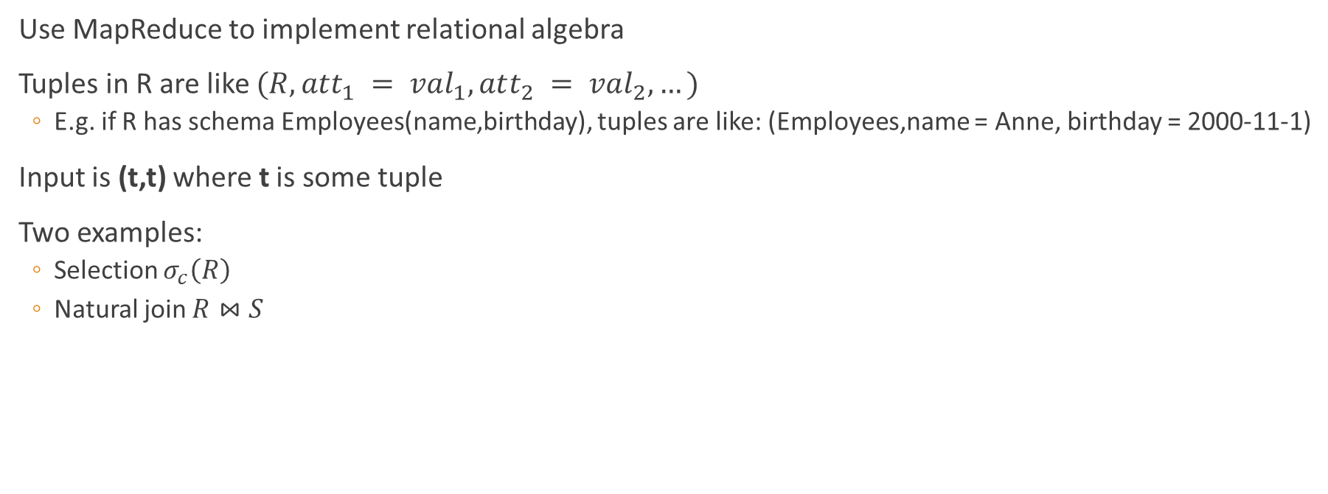
Relational algebra
Use MapReduce to implement relational algebra
Tuples in R are like $(R,att_{1} = val_{1},att_{2} = val_{2}, …)$
E.g. if R has schema Employees(name,birthday), tuples are like: (Employees,name = Anne, birthday = 2000-11-1)
Input is (t,t) where t is some tuple
Two examples:
Selection $σ_{c}\left(R\right)$
Natural join $R⋈S$

Slide 7

Selection $σ_{c}\left(R\right)$
Similar for everything but joins (and intersection and difference): Map does all the work
Map(String tuple, String tupleCopy):
if tuple satisfies c then output pair (tuple, tuple)
Reduce(String tuple, Iterator<String> tupleCopies):
output pair (tuple,tuple)

Slide 8
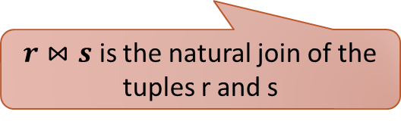


Natural join $R⋈S$
Scheme: R(A,B) and S(B,C) – A,B,C are sets of attributes
Similar for other joins
Map(String tuple, String tupleCopy):
Let Co be the attribute and value pairs in B
output pair (Co, tuple)
Reduce(String Co, Iterator<String> tuples):
for each r in tuples:
if r.relation = R then:
for each s in tuples:
if s.relation = S then:
output pair ($r⋈s,r⋈s$)
$r⋈s$ is the natural join of the tuples r and s

Slide 9
MapReduce: Closer Look

Slide 10
Distributed File System
MapReduce operates on a distributed file system
Similar to distributed DBMS
All the data is distributed over the nodes/sites
Replication is used for fault-tolerance
Appears to the user as if it was a regular file system
Implementations: Google File System, Hadoop File System

Slide 11
Inputs To MapReduce Programs
Input files to MapReduce programs can be very large (GBs/TBs in size)
Collections of web pages, links in a social network, Twitter feeds, stock market data, …
Satellite images, data from scientific experiments, …
MapReduce splits these into chunks (~16-64 MB) and provides an ID for each chunk (e.g., the filename)
Huge file/collection of files in the distributed file system
Each is a key/value pair: key = ID of chunk, value = the chunk itself

Slide 12
MapReduce Computations
(key₁, value₁), (key₂, value₂), (key₃, value₃), …, (key_{n}, value_{n})
Not keys in the database sense!
MapReduce
Computation
(key’₁, value’₁), (key’₂, value’₂), (key’₃, value’₃), …, (key’_{m}, value’_{m})
Keys/values can be arbitrary objects
Keys are typically small (e.g., integers, strings, etc.)
Values might be larger (e.g., entire text documents, images, etc.)
Each MapReduce computation is expressed in terms of two functions: Map & Reduce

Slide 13
Implementation
Map(String key, String value):
Returns a list of key/value pairs
Reduce(String key, Iterator<String> values):
Returns a list of key/value pairs
In practice also some additional code to set:
Locations of input and output files
Tuning parameters (e.g., number of machines, memory per Map/Reduce task, etc.)

Slide 14
Execution
Chunk 1
Chunk 2
Chunk 3
Chunk 4
Chunk 5
Chunk 6
Chunk 7
Map
Map
Map
Map
Map
Map
Map
Intermediate result (collection of all key/value pairs)
(key₁, values₁)
(key₂, values₂)
(key₃, values₃)
(key₄, values₄)
Reduce
Reduce
Reduce
Reduce
Output file 1
Output file 2
Output file 3
Output file 4

Slide 15
Expressiveness
MapReduce can be used to compute a number of interesting functions on large datasets
We have seen:
Counting the number of occurrences of each word
Operators of relational algebra
Matrix multiplication → PageRank
MapReduce is not a universal parallelism framework
Not every problem that is parallelisable can be expressed and solved nicely in MapReduce

Slide 16
Summary
MapReduce is a framework for solving problems on large volumes of data
Simple implementation: Map & Reduce
MapReduce takes care of the rest
Many interesting problems can be solved using MapReduce
Big Data tools are based on MapReduce

